Slide 1
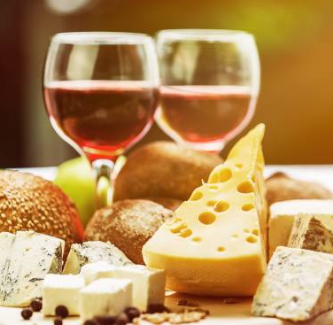
Wine and Cheese Board
A Web App by Michaela Cook

Slide 2
Project Overview
App Summary
Project Board
User Stories
ERD
MOSCOW model
CI Pipeline
Risk Assessment
Known Issues
Live Demonstration
Future Developments
Conclusion

Slide 3
App Summary
Project Brief: To create a CRUD application with utilisation of supporting tools, methodologies and technologies that encapsulate all core modules
covered during training.
Pitch: Wine and Cheese Board is an app where users can create, edit and display their choice of wines and cheeses as well as their own pairings. Further developments of the app could allow for user registration, personalised wine-cheese recommendations and wordpress for text posts by the users.

Slide 4
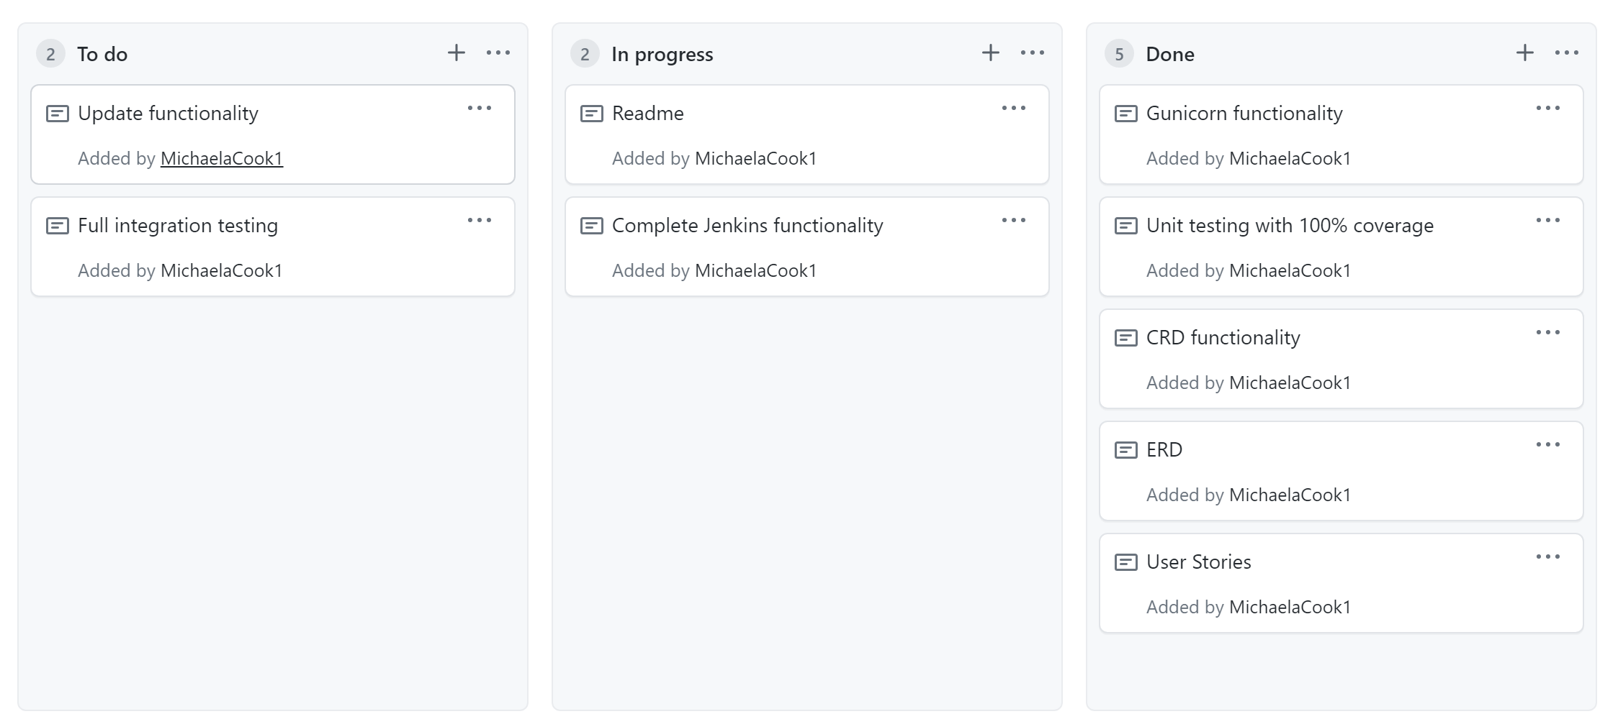
Project Board

Slide 5
User Stories
User Story 1:
As a user I want to be able to create and detail my choice of wine and cheese.
User Story 2:
As a user I want to be able to edit and delete these choices at any time.
Epic: Create a Personalised Cheese Board
User Story 3:
As a user I want to be able to create a pairing between wine and cheese based on my preference
User Story 4:
As a user I want to be given recommendations based on the wines and cheeses I enter into the app.

Slide 6
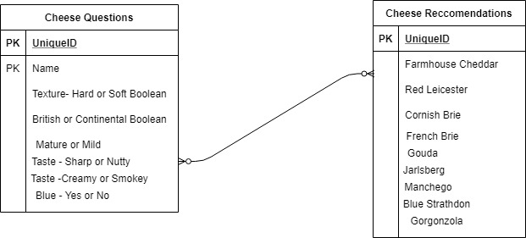
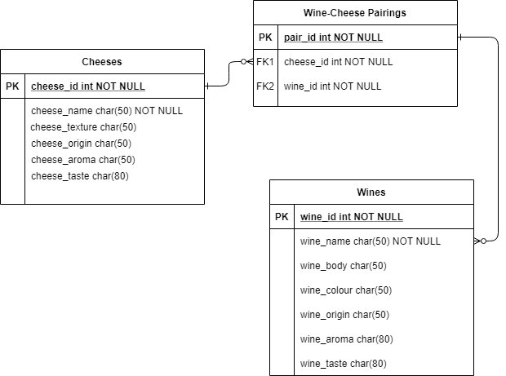
ERD
Initial ERD detailing relation between cheese questions and cheese recommendations within database.
Next Version will be optimised to include “Cheese Questions” as a form completely within Flask/Python and will include an intermediate table where “Cheese Recommendations” will have a many-to-many relationship to “Wine Pairings”
Below is an updated ERD, which describes the relation in the final app version. Due to the complexity and time given the cheese questionnaire element was removed, and instead allowing all cheese and wines to be user inputs, including a pairing intermediate table.

Slide 7
MOSCOW Model
M – MUST HAVE: CRUD capability, 2 related databases, clear documentation, trello board, functioning flask front-end, code fully integrated into VCS, and fully designed test suite
O –
S – SHOULD HAVE: Many-Many database relation with an intermediate wine-cheese pairing
C – COULD HAVE: Wine and Cheese recommendations based on user input, app run in background using Gunicorn
O –
W – WON’T HAVE: sharing links between social media platforms, wine clink animation using CSS, wordpress for user posts

Slide 8
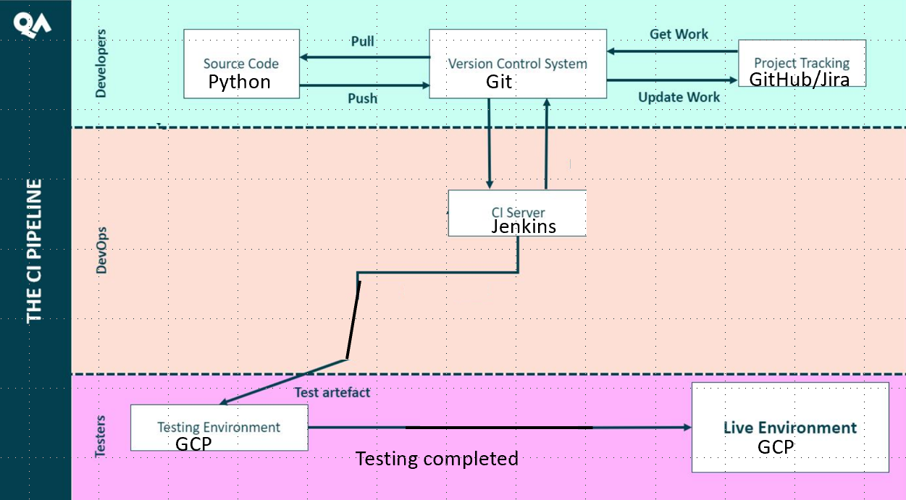
CI Pipeline

Slide 9
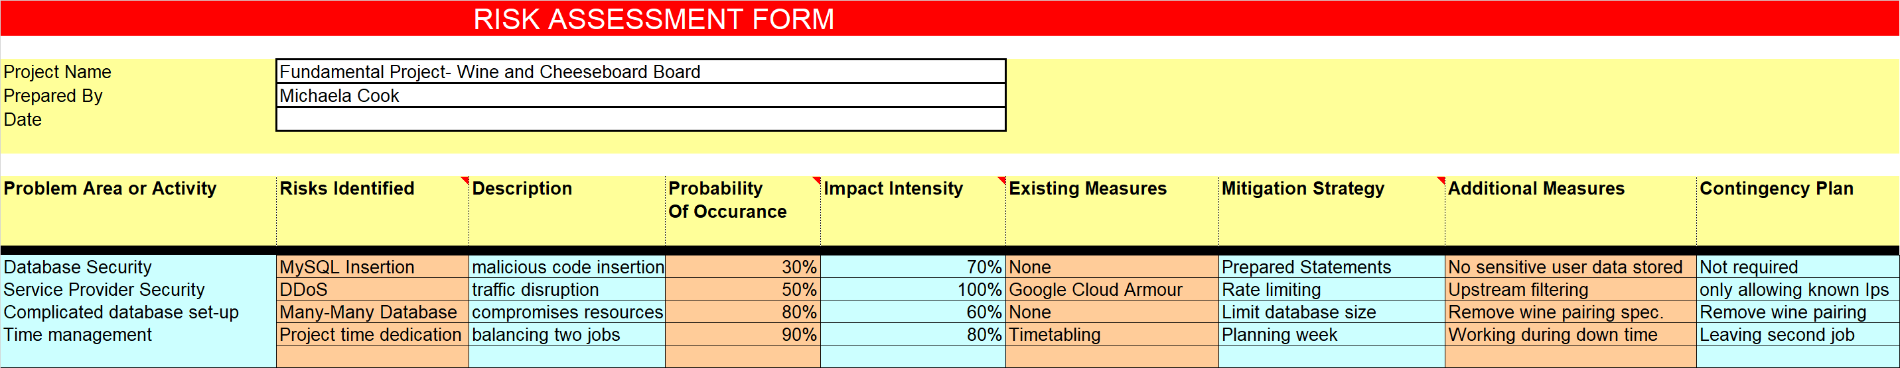
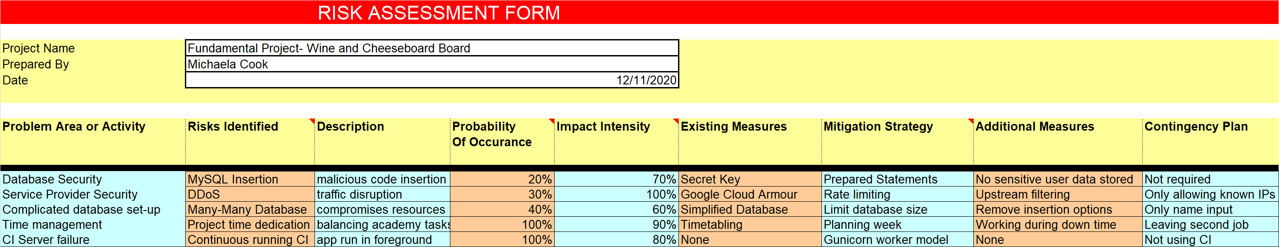
Risk Assessment

Slide 10
Known Issues
After troubleshooting “Update” does not work on the app due to an Attribute error, that I have been unable to fix within the time.
Within the Unit testing when testing the “Wine” table all tests passed bar one where an UnmappedInstanceError occurred, unable to find the cause I removed the Wine table from the test to ensure a fully passed result with 100% coverage.
Within the Integrated testing a SyntaxError appears for the xpath of the add functionality, as said path has been copied from the app itself, I could not source this error.

Slide 11
Live Demonstration
Here I will be moving to a live demonstration of my application, which is fully run as a background application using Gunicorn.
External ip for application:35.246.75.103:5000

Slide 12
Further Developments
Upon resolution of the known software issues, further developments can be made to the application.
Aesthetic additions to the html – background image, bootstrap, CSS etc.
User registration and login capability
Wordpress implementation for text posts.

Slide 13
Conclusion
Overall I was successful in creating a flask web application covering the core modules I have learned over the course of the Academy.
While due to time constraints, and listed software issues the application did not have full “CRUD” functionality, in its current state it allows the creation, addition and deletion of database entries across three tables, and was tested and analysed to a high degree.
Given more time, with the test analysis that conducted, full CRUD functionality could be obtained.

